Slide 1
Software Project Management
Software effort estimation
Dr. D Evangelin geetha
Associate professor
Department of master of computer applications
Ramaiak institute of technology
Bangalore - 560054

Slide 2
Learning objectives
Avoid the dangers of unrealistic estimates
Understand the range of estimating methods that can be used
Estimate projects using a bottom-up approach
Estimate the effort needed to implement software using a procedural programming language
Count the function points for a system
Understand the COCOMO II approach and use it to estimate project effore

Slide 3
What makes a successful project?
Delivering:
  agreed functionality
  on time
  at the agreed cost
  with the required quality
Stages:
  set targets
  Attempt to achieve targets

Slide 4
Software effort estimation: Introduction
Effort – affect cost
Activity duration – affect the delivery time

Slide 5
Difficulties in estimation
Complexity and invisibility of software
Subjective nature of estimating
  Underestimate or over-estimate
  Political implications
  Changing technology
  Lack of homogenety

Slide 6
Difficulties in estimation
Political implications
  Different groups have different objectives
  Suggestion: Estimates be produced by a specialist estimating group
    Developers
Changing technology
  Experience of previous projects cannot be used
Lack of homogeneity of project experience
  Other differences between projects.
  E.g. ‘testing’

Slide 7
Where are the Estimates done?
Strategic planning
Feasibility study
System specification
Evaluation of suppliers’ proposals
Project planning

Slide 8
Problems with over and under estimates
Parkinson’s Law:
  Work expands to fill the time available
Brooks’ Law:
  Disproportionately with the number of staff
  ‘putting more people on a late job makes it later’

Slide 9
Problems with over and under estimates
Danger with the under-estimate is the effect on quality
Weinberg’s zeroth law of reliability
  ‘if a system does not have to be reliable, it can meet any other objective’
Motivation and morale are enhanced where targets are achievable
An estimate is not really a prediction, it is a management goal

Slide 10
The basis for software estimating
The need for historical data
Parameters to be estimated
Measure of work
Measure of effort

Slide 11
The basis for software estimating
The need for historical data
  Information about past projects
  Differences in programming languages and experience of staff
  Externally maintained datasets of project performance data can be accessed
  International Software Benchmarking Standards Group (ISBSG)

Slide 12
The basis for software estimating
Parameters to be estimated
  Effort and duration
  Duration – measured in months
  Effort – Work-month (wm) or person-month (pm)

Slide 13
The basis for software estimating
Person Month
  Suppose a project is estimated to take 300 person-months to develop:
    Is one person working for 30 days same as 30 persons working for 1 day?
    No? why?
  How many hours is a man month:
    Default Value: 152 hours per month
    19 days at 8 hours per day

Slide 14
The basis for software estimating
Why Person-Month and not Person-days or Person years?
  Modern Projects typically take a few months to complete...
  Person-years is clearly unsuitable.
  Person-days would make monitoring and estimation overhead large and tedious.

Slide 15
The basis for software estimating
Measure of work
  Size of the project
  Work is characterized by cost and time
  First estimate size and then estimate cost and time
  Size – independent variable
  Cost and time – dependent variables

Slide 16
The basis for software estimating
Measure of work – ‘Project Size’
  Measure of problem complexity in terms of effort and time
  Metrics
    Source Lines of Code (SLOC)
      No precise definition
      Difficult to estimate at start of a project
      Only a code measure
      Programmer – dependent
      Does not consider code complexity
    Function Point (FP)

Slide 17
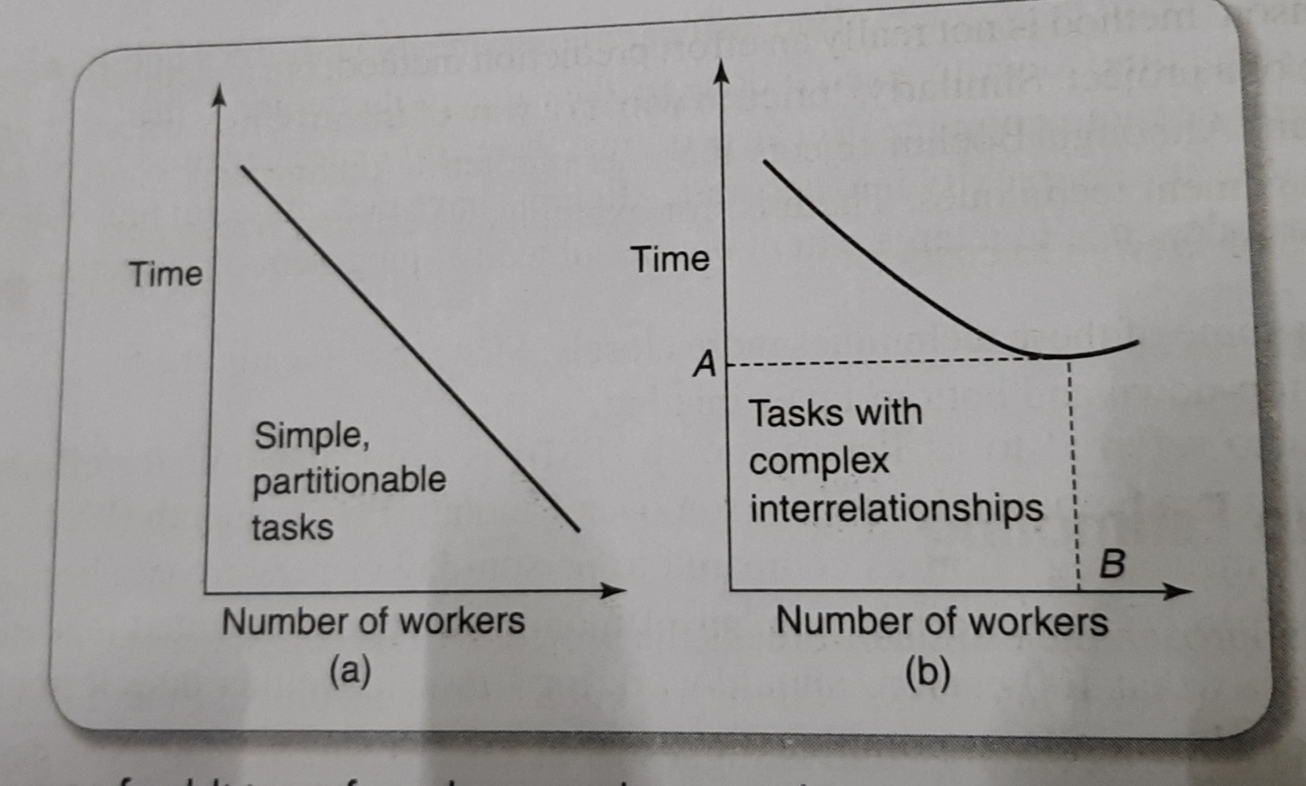
The basis for software estimating
Measure of effort
  Person-Month (PM)
  100 PM
  Why progress can not be measured as the product of men and months?
    Effort in communications dominate actual work
    2 parts: Training and intercommunications
    Pairwise communication - n(n-1)/2

Slide 18
Software effort estimation techniques
Barry Boehm:
  Algorithmic models
  Expert judgement
  Analogy
  Parkinson
  Price to win
  Top-down
  Bottom-up

Slide 19
Bottom-up estimating
Break the project into its component tasks
Task could be done in a week or two
Best at the later stages
Top-down – Work Break down structure

Slide 20
Bottom-up estimating
A procedural code-oriented approach
  Envisage the number and type of software modules in the final system
  Estimate the SLOC of each identified module
  Estimate the work content, taking into account complexity and technical difficulty
  Calculate the work-days effort

Slide 21
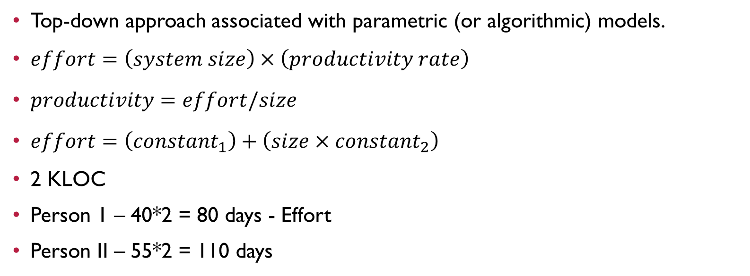
The top-down approach and parametric models
Top-down approach associated with parametric (or algorithmic) models.
$effort=\left(system size\right)×\left(productivity rate\right)$
$productivity=effort/size$
$effort=\left({constant}_{1}\right)+\left(size×{constant}_{2}\right)$
2 KLOC
Person 1 – 40*2 = 80 days - Effort
Person II – 55*2 = 110 days
Eqn. of a straight line is y=mx+c

Slide 22
Expert judgement
From a knowledgeable person
Effort needed to change an existing piece of software

Slide 23
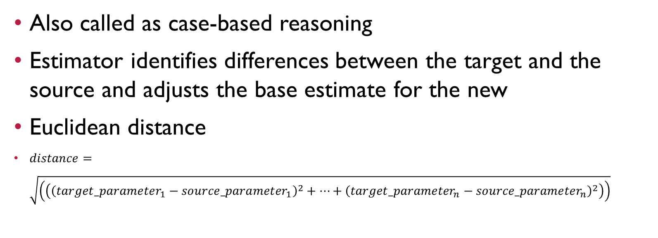
Estimating by analogy
Also called as case-based reasoning
Estimator identifies differences between the target and the source and adjusts the base estimate for the new
Euclidean distance
$distance=\sqrt{\left(\left({\left({target_parameter}_{1}−{source_parameter}_{1}\right)}^{2}+…+{\left({target_parameter}_{n}−{source_parameter}_{n}\right)}^{2}\right)\right)}$

Slide 24
Estimating by analogy
Example
The new project is known to require 7 inputs and 15 outputs. One of the past cases, project A has 8 inputs and 17 outputs. Project B has 5 inputs and 10 outputs. What would be the Euclidean distance between the projects A and B and target project. Which one is better?

Slide 25
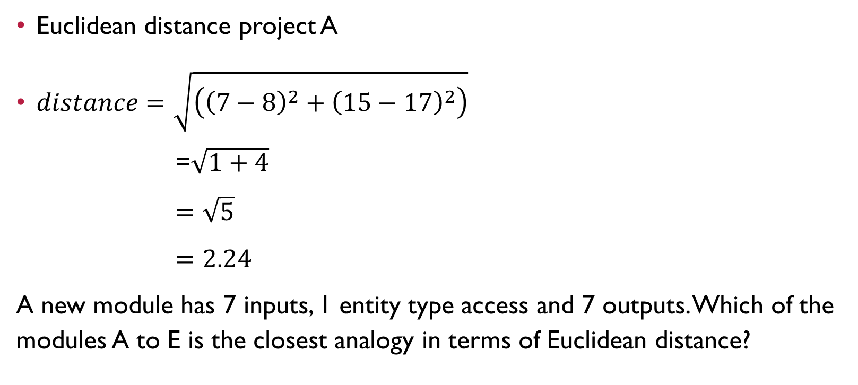
Estimating by analogy
Euclidean distance project A
$distance=\sqrt{\left({\left(7−8\right)}^{2}+{\left(15−17\right)}^{2}\right)}$
=$\sqrt{1+4}$
$=\sqrt{5}$
$=2.24$
A new module has 7 inputs, 1 entity type access and 7 outputs. Which of the modules A to E is the closest analogy in terms of Euclidean distance?
Module | Inputs | Entity Type Accessed | Outputs
A | 1 | 2 | 10
B | 10 | 2 | 1
C | 5 | 1 | 1
D | 2 | 3 | 11
E | 1 | 3 | 20

Slide 26
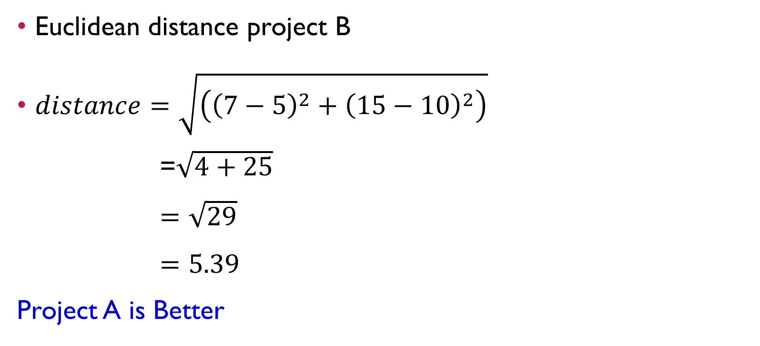
Estimating by analogy
Euclidean distance project B
$distance=\sqrt{\left({\left(7−5\right)}^{2}+{\left(15−10\right)}^{2}\right)}$
=$\sqrt{4+25}$
$=\sqrt{29}$
$=5.39$
Project A is Better

Slide 27
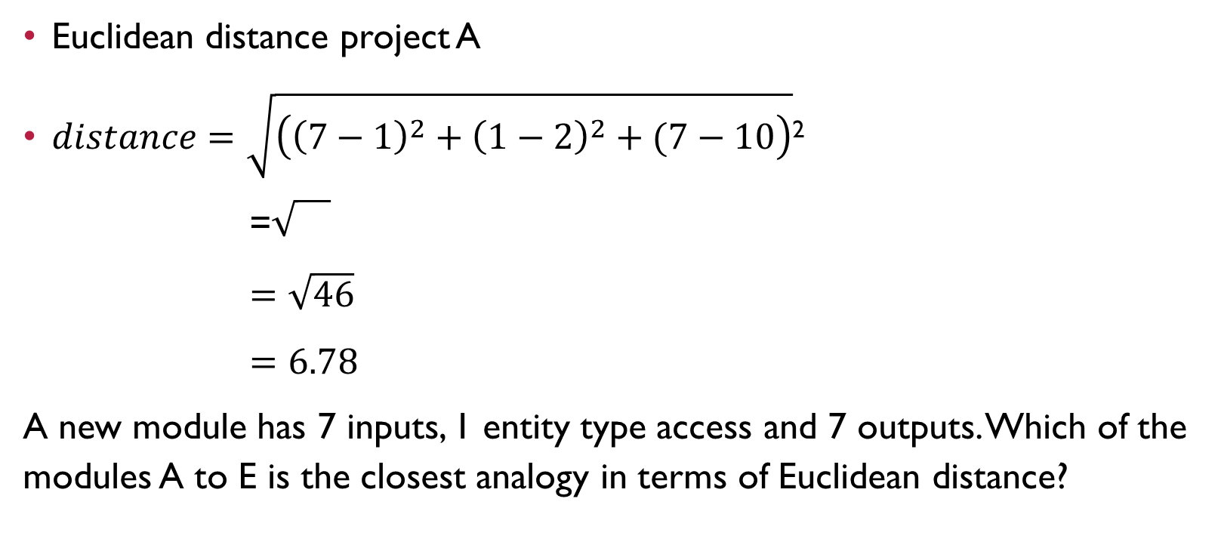
Estimating by analogy
Euclidean distance project A
$distance=\sqrt{\left({\left(7−1\right)}^{2}+{\left(1−2\right)}^{2}+(7−10\right)}$²
=
$=\sqrt{46}$
$=6.78$
A new module has 7 inputs, 1 entity type access and 7 outputs. Which of the modules A to E is the closest analogy in terms of Euclidean distance?
Module | Inputs | Entity Type Accessed | Outputs
A | 1 | 2 | 10
B | 10 | 2 | 1
C | 5 | 1 | 1
D | 2 | 3 | 11
E | 1 | 3 | 20

Slide 28
Albrecht Function Point Analysis
Top-down method
Functional size of programs independently of their programming languages
Basis is 5 major components – External user types
  External input
  External output
  External inquiry types
  Logical internal file types
  External interface file types
External user type | Multiplier
 | Low | Average | High
External input type | 3 | 4 | 6
External output type | 4 | 5 | 7
External inquiry type | 3 | 4 | 6
Logical internal file type | 7 | 10 | 15
External interface file type | 5 | 7 | 10

Slide 29
Albrecht Function Point Analysis
IFPUG file type complexity
Number of Record Types | Number of data types
 | <20 | 20-50 | >50
1 | Low | Low | Average
2 to 5 | Low | Average | High
>5 | Average | High | High

Slide 30
Albrecht Function Point Analysis
Example
A logical internal file might contain data about purchase orders. These purchase orders might be organized into two separate record types: the main PURCHASE-ORDER details, namely purchase order number, supplier reference and purchase order date, and then details for each PURCHASE-ORDER-ITEM specified in the order, namely, the product code, the unit price and number ordered.

Slide 31
Albrecht Function Point Analysis
Example - Solution
A logical internal file might contain data about purchase orders. These purchase orders might be organized into two separate record types: the main PURCHASE-ORDER details, namely purchase order number, supplier reference and purchase order date, and then details for each PURCHASE-ORDER-ITEM specified in the order, namely, the product code, the unit price and number ordered. The number of record types for that file would be 6.
The number of record types – 2
No. of data types - 6
File type – low
FP count - 7

Slide 32
Function points mark ii
Sponsored by then the CCTA (Central Computer and Telecommunications Agency) now, OGC (Office of Government Commerce)
Improvement and replacement of the Albrecht method
The information processing size is initially measured in unadjusted function points (UFPs)
A technical complexity adjustment can be applied (TCA)

Slide 33
Function points mark ii
Datastore
Input
Process
Output
From user
Return to user

Slide 34
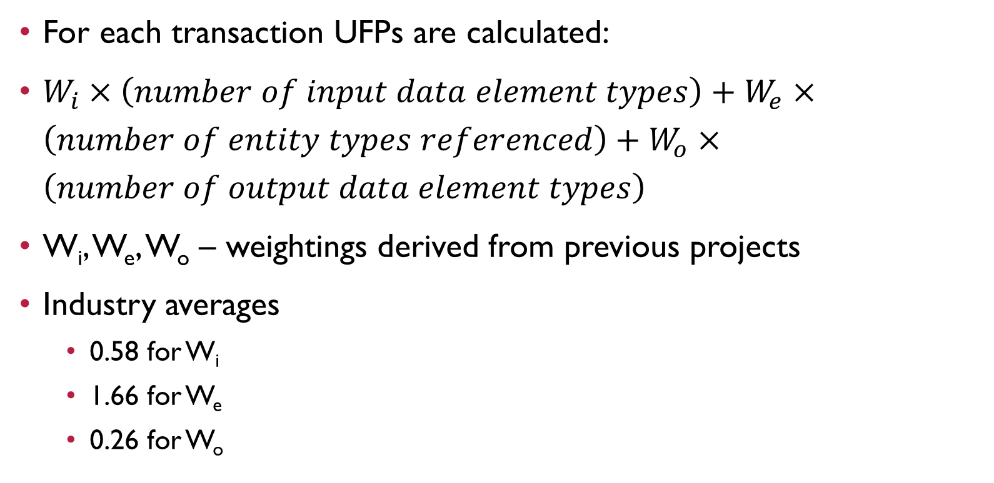
Function points mark ii
For each transaction UFPs are calculated:
$W_{i}×\left(number of input data element types\right)+W_{e}×\left(number of entity types referenced\right)+W_{o}×\left(number of output data element types\right)$
W_{i}, W_{e}, W_{o} – weightings derived from previous projects
Industry averages
  0.58 for W_{i}
  1.66 for W_{e}
  0.26 for W_{o}

Slide 35
Function points mark ii
Exercise
A cash receipt transaction in the IOE maintenance accounts subsystem accesses two entity types – INVOICE and CASH-RECEIPT.
The data inputs are:
  Invoice number
  Date received
  Cash received
If an INVOICE record is not found for the invoice number then an error message is issued. If the invoice number is found then a CASH-RECEIPT record is created. The error message is the only output of the transaction.
The unadjusted function points, using the industry average weightings, for this transaction is Wi*Ni+We*Ne+Wo*No = 0.58*3+1.66*2+0.26*1= 5.32

Slide 36
One system delivering the same functionality as another may be more difficult to implement
  Incorporation of additional security measures would increase the amount of effort
  Symons – against to use FPs to estimate SLOC rather than effort
  Productivity – effort per function point

Slide 37
COSMIC Full Function points
IFPUG (International FP User Group) – not helpful for real-time or embedded applications
  COSMIC FFP – Common Software Measurement Consortium

Slide 38
COSMIC Full Function points
Entries (E)
Exits (X)
Reads (R)
Writes (W)
Unit Cfsu (COSMIC functional size units)

Slide 39
COCOMO II: A parametric productivity model

Slide 40
COCOMO II: A parametric productivity model
Boehm’s COCOMO (COnstructive COst MOdel)
COCOMO - refers to a group of models
Late 1970s - on a study of 63 projects

Slide 41

COCOMO II: A parametric productivity model
COCOMO81
Basic model was built around the equation
effort - measured in pm (person-months)
c, k - constants
$$effort = c{\left(size\right)}^{k}$$

Slide 42
COCOMO II: A parametric productivity model - COCOMO81 constants
System type | c | k
Organic | 2.4 | 1.05
Semi-detached | 3.0 | 1.12
Embedded | 3.6 | 1.20
Constants c and k depends on 3 classifications: Organic, Semi-detached and Embedded
  Organic mode:
    system is small, interface requirements flexible
    developed by small teams and in-house environment
  Embedded mode:
    Product had to operate within very tight constraints and changes to the system were very costly
  Semi-detached mode:
    combined elements of Organic and Embedded or had characteristics that came between the two

Slide 43
COCOMO II: A parametric productivity model
Refined estimation model
uses various multipliers and exponents
Models for 3 different stages.
  Application Composition
  Early design
  Post Architecture

Slide 44
COCOMO II: A parametric productivity model
COCOMO81: 50-100 percent error
COCOMO II: increasing accuracy

Slide 45
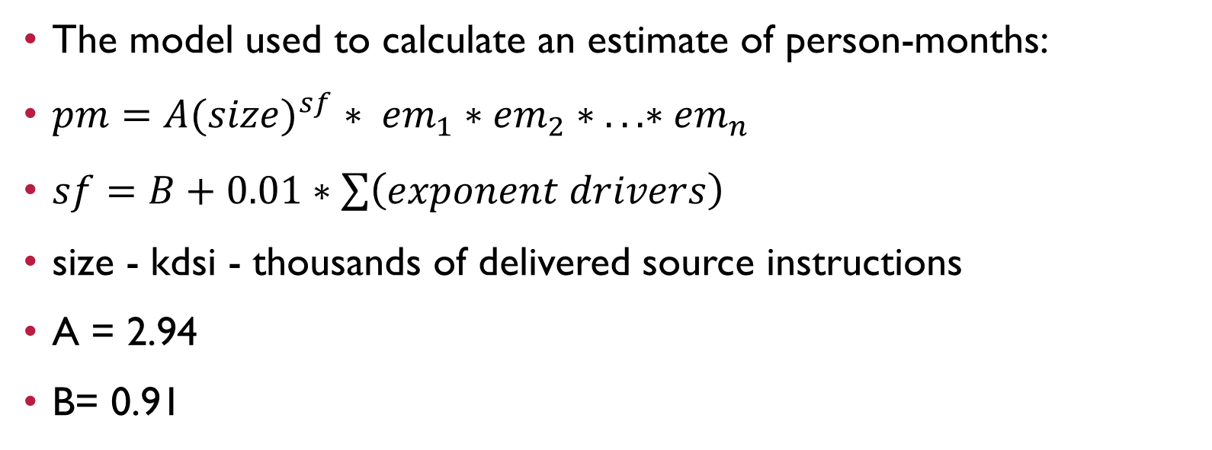
COCOMO II: A parametric productivity model
The model used to calculate an estimate of person-months:
$pm=A{(size)}^{sf} ∗ {em}_{1}∗{em}_{2}∗ ...∗{em}_{n}$
$sf=B+0.01∗\sum{\left(exponent drivers\right)}$
size - kdsi - thousands of delivered source instructions
A = 2.94
B= 0.91

Slide 46
COCOMO II: A parametric productivity model
The factors that exponent drivers
Precedentedness (PREC)
Development flexibility (FLEX)
Architecture/risk resolution (RESL)
Team cohesion (TEAM)
Process maturity (PMAT)

Slide 47
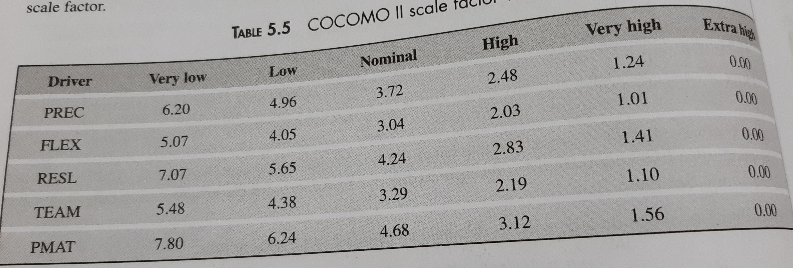

Slide 48
COCOMO II: A parametric productivity model
Effort multipliers (em) adjust the estimate to take account of productivity factors

Slide 49
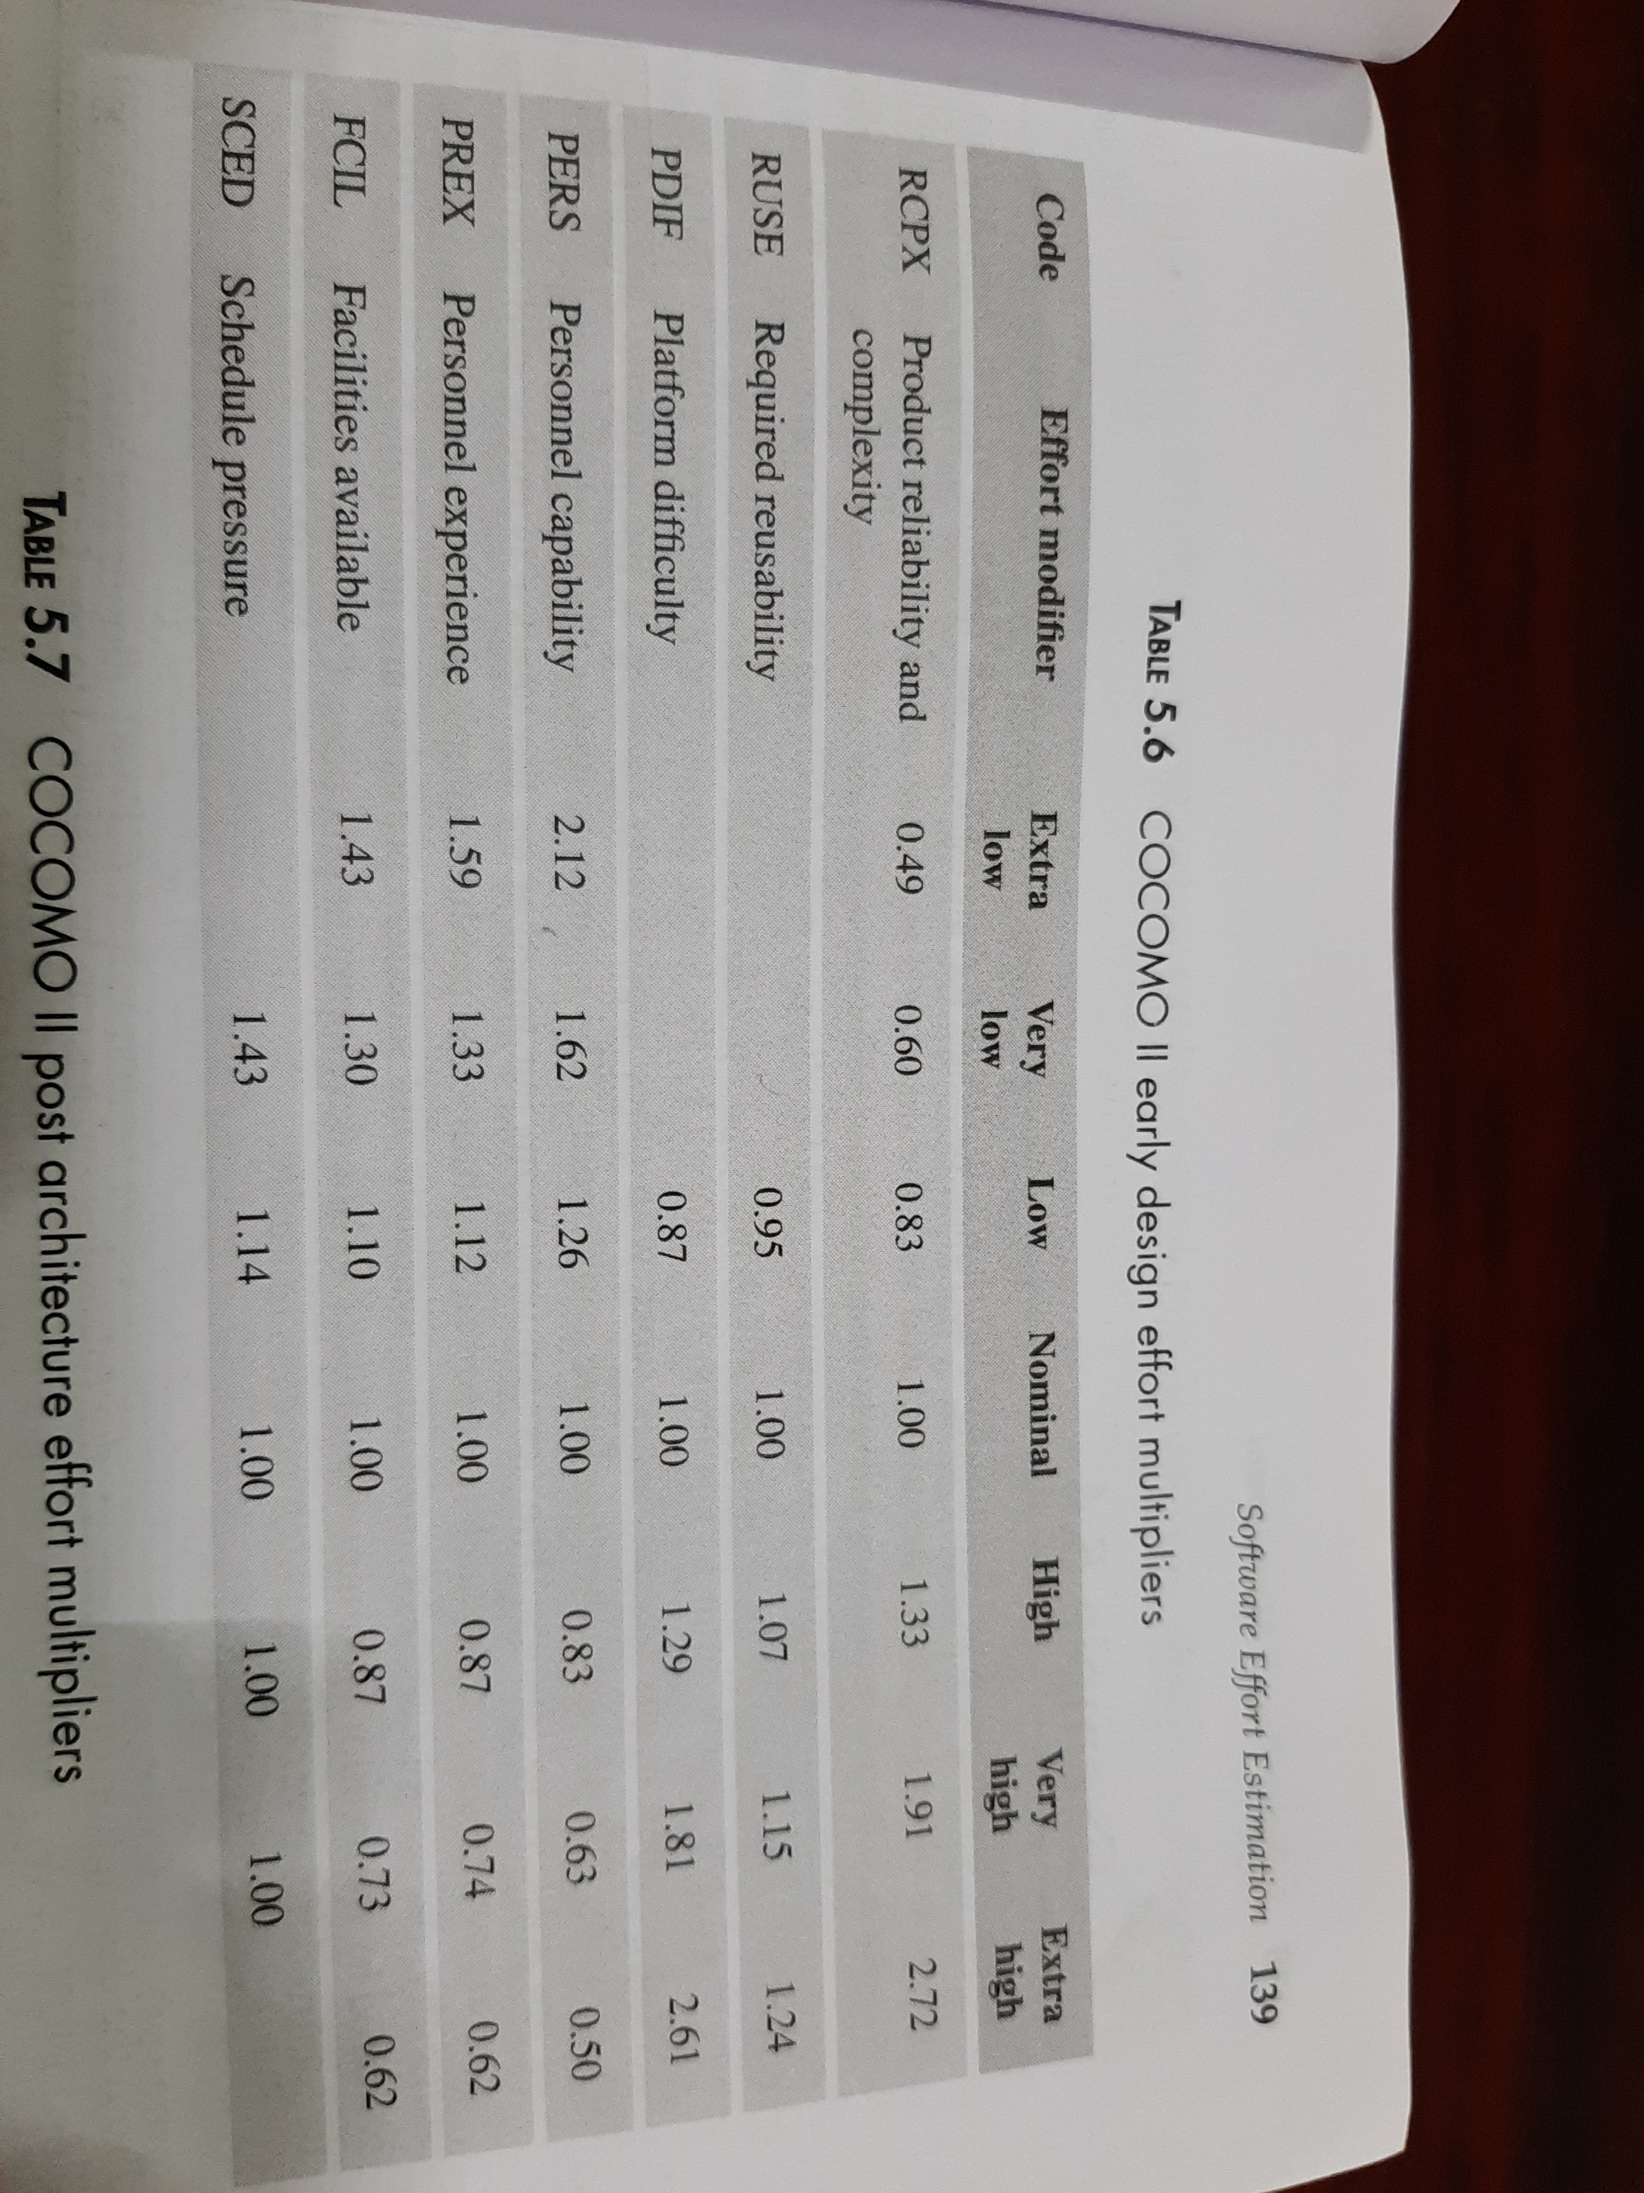

Slide 50
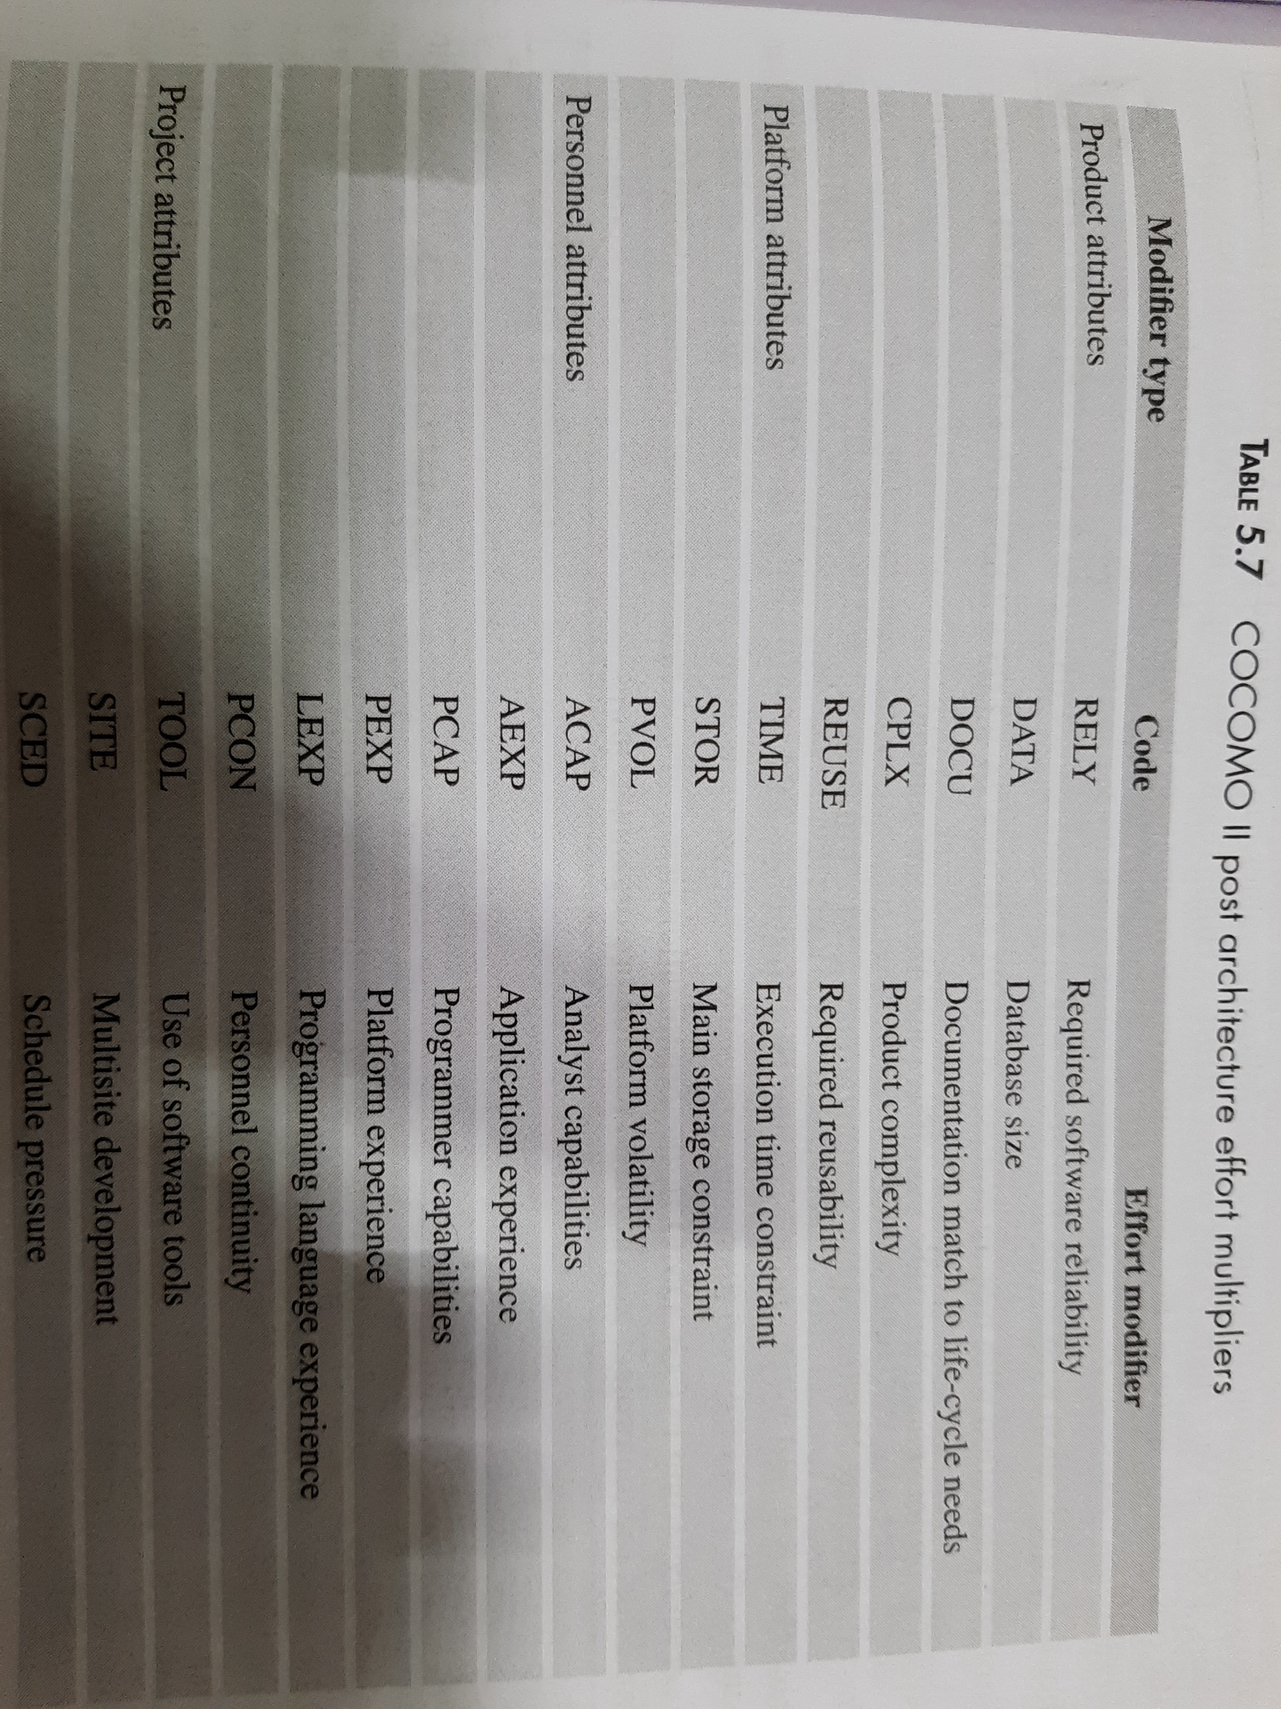

Slide 51
Example 5.4
Consider a company is developing a software package for an educational institute that would automate various bookkeeping activities associated with the institute’s academic activities such as course registration and grading. The institute has already installed other software applications that automate its various activity areas such as stores and purchase, accounting and faculty pay roll, which are already operational. The size of code that is expected to be written for the academic package is 10,000 SLOC. The package to be developed by a vendor is very similar to a software developed by the same vendor for a different client. The software to be developed needs to seamlessly work with other applications running at the institute and has to use the existing DBMS and other hardware components. The requirements for the academic package are clear and re unlikely to change the development team put together by the vendor is collocated and cohesive. Other aspects of the project such as required reliability and product complexity, required reusability, platform difficulty, personal capability, facilities available and schedule pressure ae nominal. Determine the effort required by the vendor assuming that it uses ad hoc development practices. Compare the effort to what would be incurred if the vendor had high process maturity.
PREC – FLEX - RESL – TEAM - PMAT -

Slide 52
Example 5.4
Consider a company is developing a software package for an educational institute that would automate various bookkeeping activities associated with the institute’s academic activities such as course registration and grading. The institute has already installed other software applications that automate its various activity areas such as stores and purchase, accounting and faculty pay roll, which are already operational. The size of code that is expected to be written for the academic package is 10,000 SLOC. The package to be developed by a vendor is very similar to a software developed by the same vendor for a different client. The software to be developed needs to seamlessly work with other applications running at the institute and has to use the existing DBMS and other hardware components. The requirements for the academic package are clear and are unlikely to change the development team put together by the vendor is collocated and cohesive. Other aspects of the project such as required reliability and product complexity, required reusability, platform difficulty, personal capability, facilities available and schedule pressure ae nominal. Determine the effort required by the vendor assuming that it uses ad hoc development practices. Compare the effort to what would be incurred if the vendor had high process maturity.
PREC – Very High FLEX - Low RESL – High TEAM – Very High PMAT – Very Low/ Very High

Slide 53
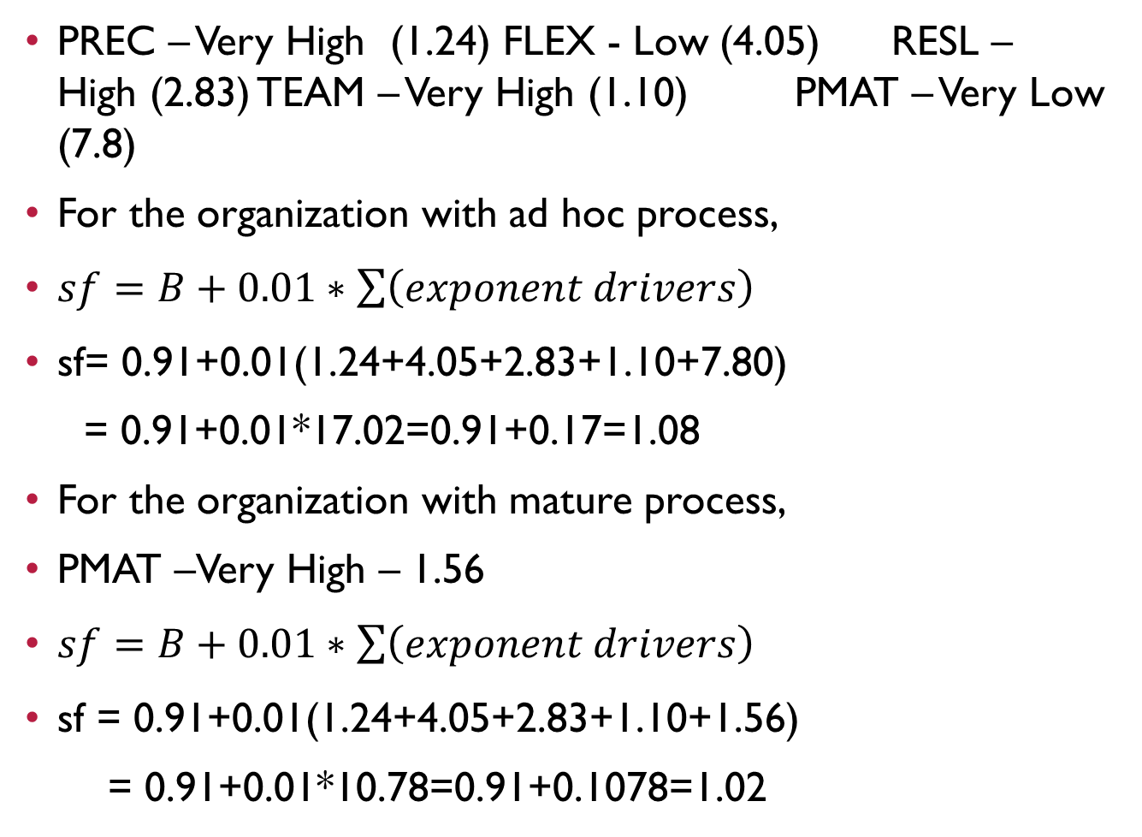
PREC – Very High (1.24) FLEX - Low (4.05) RESL – High (2.83) TEAM – Very High (1.10) PMAT – Very Low (7.8)
For the organization with ad hoc process,
$sf=B+0.01∗\sum{\left(exponent drivers\right)}$
sf= 0.91+0.01(1.24+4.05+2.83+1.10+7.80)
= 0.91+0.01*17.02=0.91+0.17=1.08
For the organization with mature process,
PMAT –Very High – 1.56
$sf=B+0.01∗\sum{\left(exponent drivers\right)}$
sf = 0.91+0.01(1.24+4.05+2.83+1.10+1.56)
= 0.91+0.01*10.78=0.91+0.1078=1.02

Slide 54
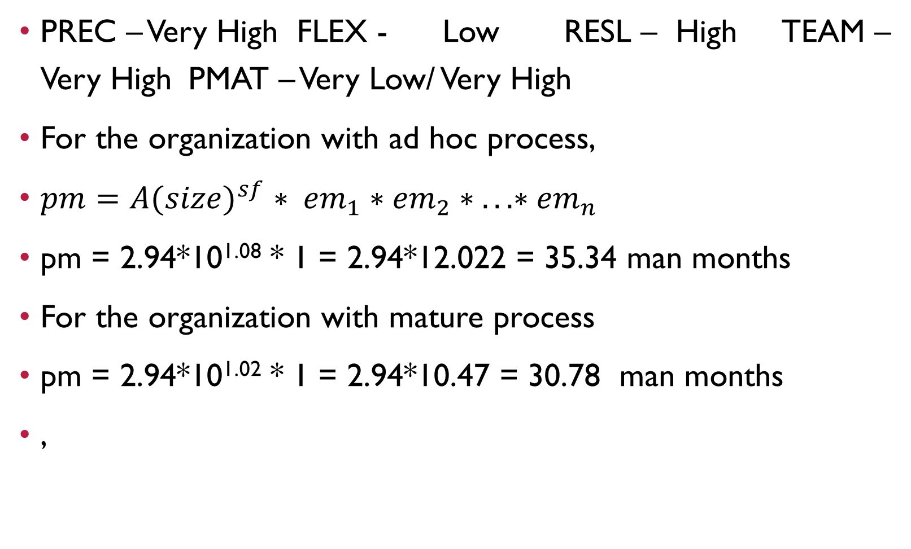
PREC – Very High FLEX - Low RESL – High TEAM – Very High PMAT – Very Low/ Very High
For the organization with ad hoc process,
$pm=A{(size)}^{sf} ∗ {em}_{1}∗{em}_{2}∗ ...∗{em}_{n}$
pm = 2.94*10^{1.08} * 1 = 2.94*12.022 = 35.34 man months
For the organization with mature process
pm = 2.94*10^{1.02} * 1 = 2.94*10.47 = 30.78 man months
,

Slide 55
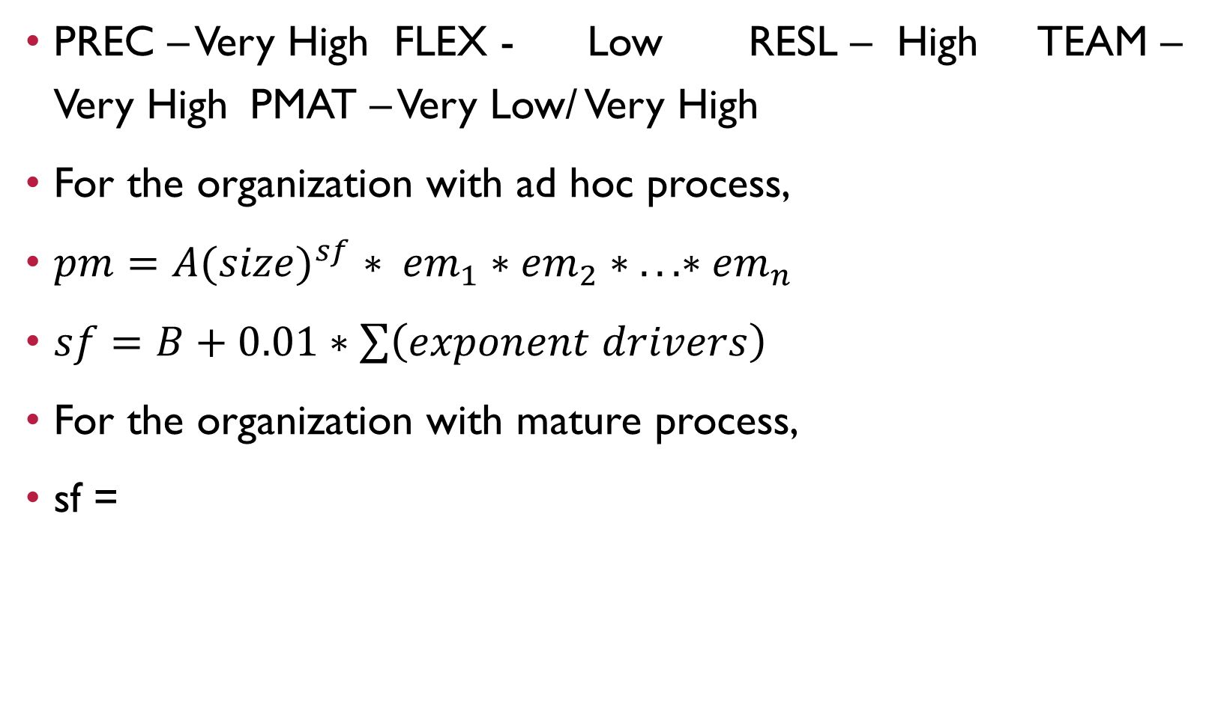
PREC – Very High FLEX - Low RESL – High TEAM – Very High PMAT – Very Low/ Very High
For the organization with ad hoc process,
$pm=A{(size)}^{sf} ∗ {em}_{1}∗{em}_{2}∗ ...∗{em}_{n}$
$sf=B+0.01∗\sum{\left(exponent drivers\right)}$
For the organization with mature process,
sf =

Slide 56

The size of the project to be developed is 30,000 SLOC and the nature of the project is semi-detached. Find the effort. (COCOMO81)
Effort = 3.0*30^{1.12} = 3.0 * 45.12 = 135.36 man months
$$effort = c{\left(size\right)}^{k}$$

